Slide 1
Module 7

Slide 2
Contents
Product and Process Metrics,
Quality Standards Models ISO,
TQM,
Six-Sigma,
Process improvement Models: CMM & CMMI.
Quality Control and Quality Assurance
Quality Management
Quality Factors
Methods of Quality Management

Slide 3
Software Metrics

Slide 4
Software Metrics
A software metric is a measure of software characteristics which are measurable or countable.
Software metrics are valuable for many reasons, including measuring software performance, planning work items, measuring productivity, and many other uses.
Software metrics are similar to the four functions of management:
Planning,
Organization,
Control, or
Improvement.

Slide 5
Classification of Software Metrics
Software metrics can be classified into two types as follows:
1. Product Metrics
2. Process Metrics

Slide 6
Product Metrics
These are the measures of various characteristics of the software product. The two important software characteristics are:
Size and complexity of software.
Quality and reliability of software.
These metrics can be computed for different stages of SDLC.

Slide 7
Process Metrics
These are the measures of various characteristics of the software development process.
For example, the efficiency of fault detection.
It is used to measure the characteristics of methods, techniques, and tools that are used for developing software.

Slide 8
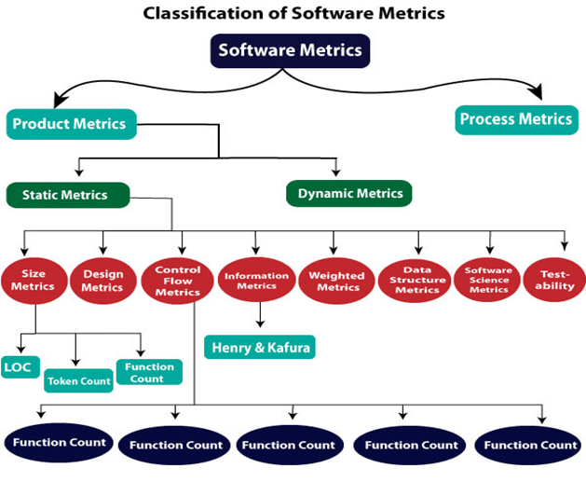

Slide 9
Size Oriented Metrics (LOC)
LOC divides the entire project into several modules and sub-modules until the size of the leaf module is approximately predicted.
LOC count the total number of lines of source code in a project. The units of LOC are:
LOC- lines of code (without comments)
LLOC- Logical line of code (for logical statement counting)
Comment Line
KLOC-lines of code including comments

Slide 10
Example
/* Now how many lines of code is this? */
for (i = 0; i < 100; i++)
{
printf("hello");
}
Compute LOC:
LOC=4
LLOC=2
Comment=1
KLOC=5

Slide 11
for (i = 0; i < 100; i++) printf("hello"); /* How many lines of code is this? */
Compute LOC:

Slide 12
Other Metrics based on LOC
Errors/KLOC.
$/ KLOC.
Defects/KLOC.
Pages of documentation/KLOC.
Errors/PM.
Productivity = KLOC/PM (effort is measured in person-months).
$/ Page of documentation.

Slide 13
Function Point Analysis
In this method, the number and type of functions supported by the software are utilized to find FPC(function point count).
The steps in function point analysis are:
Count the number of functions of each proposed type.
Compute the Unadjusted Function Points(UFP).
Find Total Degree of Influence(TDI).
Compute Complexity Adjustment Factor(CAF).
Find the Function Point Count(FPC).

Slide 14
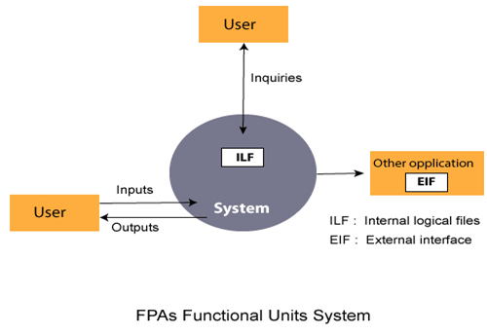

Slide 15
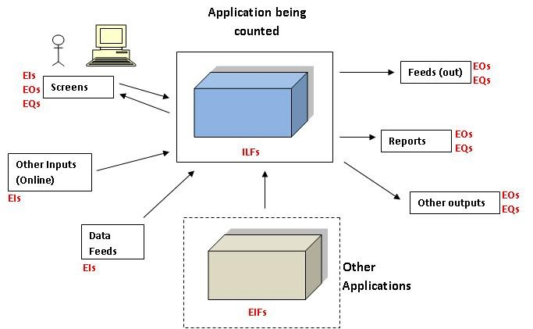

Slide 16
Extended Function Point (EFP) Metrics
FP metric has been further extended to compute:
Feature points.
3D function points.

Slide 17
Feature points
Feature point is the superset of function point measure that can be applied to systems and engineering software applications.
The feature points are used in those applications in which the algorithmic complexity is high like real-time systems where time constraints are there, embedded systems, etc.
Feature points are computed by counting the information domain values and are weighed by only single weight.
Feature point includes another measurement parameter-ALGORITHM
Function point and feature point both represent systems functionality only.
feature point = UAF x CAF + {12 x 15 x CAF}

Slide 18
3D Function Points
Three dimensions is used to represent 3D function points:
Data dimension, Functional dimension, and Control dimension.
The data dimension is evaluated as FPs are calculated. Herein, counts are made for inputs, outputs, inquiries, external interfaces, and files.
The functional dimension adds another feature-Transformation, that is, the sequence of steps which transforms input to output.
The control dimension that adds another feature-Transition that is defined as the total number of transitions between states. A state represents some externally observable mode.

Slide 19
Compute the 3D-function point value for an embedded system with the following characteristics: (1) Internal data structures = 6 (2) External data structures = 3 (3) No. of user inputs = 12 (4) No. of user outputs = 60 (5) No. of user inquiries = 9 (6) No. of external interfaces = 3 (7) Transformations = 36 (8) Transitions = 24 Assume complexity of the above counts is high.

Slide 20
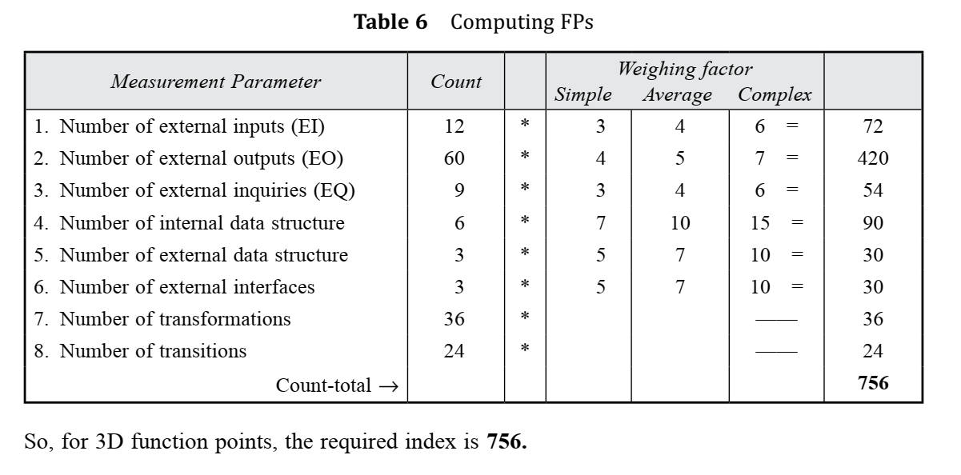

Slide 21
Advantages:
It can be easily used in the early stages of project planning.
It is independent on the programming language.
It can be used to compare different projects even if they use different technologies(database, language etc).
Disadvantages:
It is not good for real time systems and embedded systems.
Many cost estimation models like COCOMO uses LOC and hence FPC must be converted to LOC.

Slide 22
Object Oriented Metrics
Conventional Software project metrics LOC or FP can be used to estimate the object oriented software projects.
Lorenz and Kidd [1994] suggest the following set of metrics for OO projects.
Number of scenario scripts
Number of key classes
Number of Support classes.
Average number of support classes per key class
Number of subsystems.

Slide 23
Use-Case Oriented Metrics
It is use as a normalization measure similar to LOC or FP.
It is to be used for estimation before significant modeling and construction.
Use-case describe user visible functions and features that are basic requirements for a system.
The number of use-case is directly proportional to the size of the application in LOC.

Slide 24
Web Engineering Project Metrics
Number of static web pages
Number of dynamic web pages
Number of internal page links
Number of persistent data objects
Number of external system interfaced
Number of Static content objects
Number of dynamic content objects
Number of executable functions.

Slide 25
Six Sigma

Slide 26
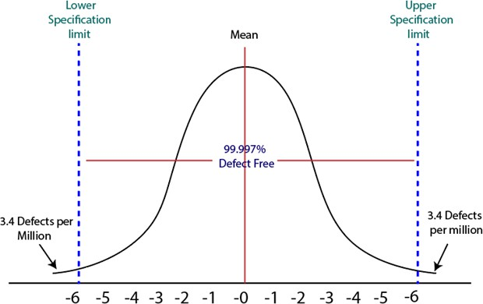
Quality Standards Models - Six Sigma
Six Sigma is the most widely used strategy for statistical quality assurance in industry today.
Six Sigma is the process of improving the quality of the output by identifying and eliminating the cause of defects and reduce variability in manufacturing and business processes.
The maturity of a manufacturing process can be defined by a sigma rating indicating its percentage of defect-free products it creates.
A six sigma method is one in which 99.99966% of all the products to be produced have the same features and are of free from defects

Slide 27
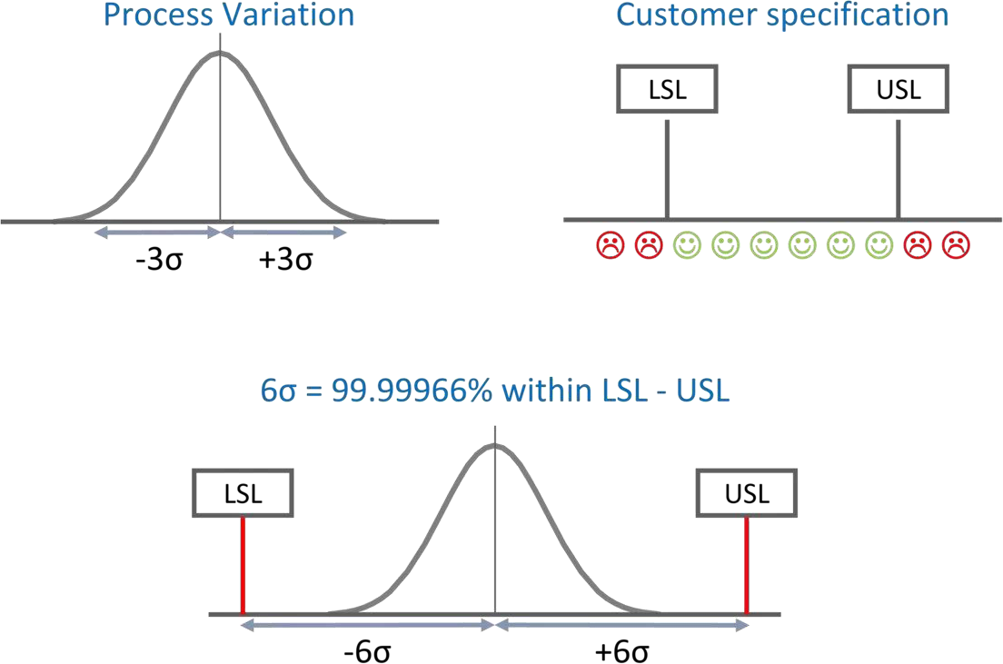

Slide 28
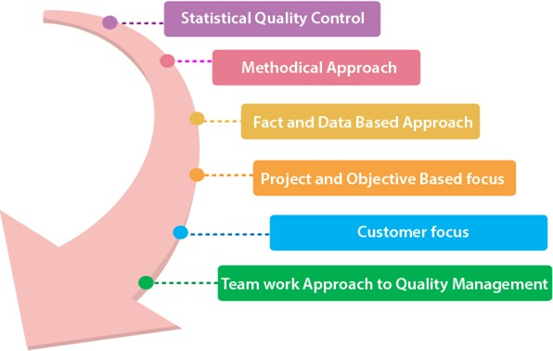
Characteristics of Six Sigma
Statistical Quality Control
Six Sigma is derived from the Greek Letter σ (Sigmat, which
is used to denote Standard
Deviation in statistics.
Standard Deviation is used for
measuring the quality of output.
Methodical Approach
The Six Sigma is a systematic approach of application in DMAIC (Define, Measure, Analyze, Improve, and Control) and DMADV (define, measure, analyze, design, and verify.) which can be used to improve the quality of production.

Slide 29
Fact and Data-Based Approach
Statistical and methodical aspect of Six Sigma shows the scientific basis of the
technique.
This highlights essential elements of the Six Sigma that is a fact and data-based.
4. Project and Objective-Based Focus
The Six Sigma process is implemented to focus on the requirements and conditions.
5. Customer Focus
The customer focus is fundamental to the Six Sigma approach.
The quality improvement and control standards are based on specific customer requirements.
Teamwork Approach to Quality Management
The Six Sigma process requires organizations to get organized for improving quality.

Slide 30
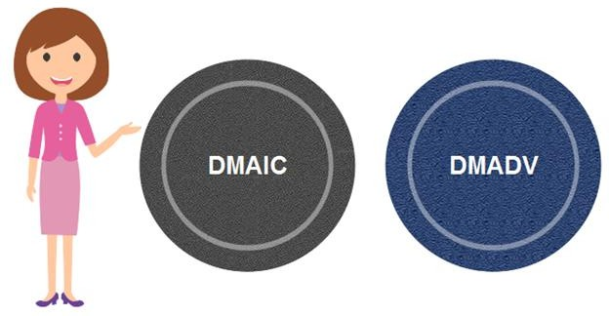
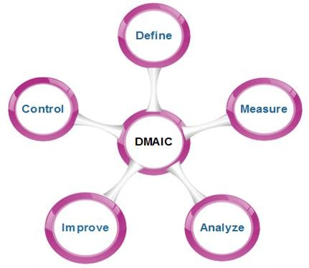
Six Sigma Methodologies
Six Sigma projects methodologies:
1. DMAIC
follow two project
It specifies a data-driven quality strategy for
improving processes.
This methodology is used to enhance an
existing business process.
DMAIC project methodology has five phases:
Define : Define customer requirements and deliverables and project goals via well- defined methods of customer communication.
Measure: Measure the existing process and its output to determine current
quality
metrics).
(iii) Analyze:
performance (collect defect
Analyze defect metrics and
determine the vital few causes.

Slide 31
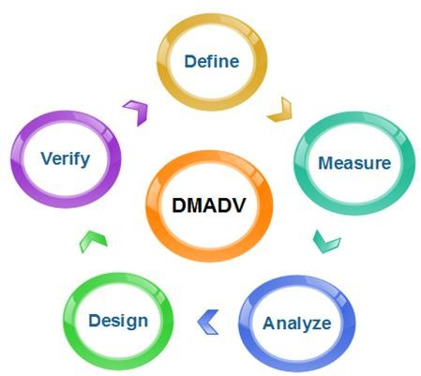
(iv) Improve: Improve the process by eliminating the root causes of defects.
(v) Control: Control the process to ensure that future work does not reestablish the causes of defects.
DMADV
It specifies a data-driven quality strategy for
designing products and processes.
This method is used to create new product designs or process designs in such a way that it results in a more predictable, mature, and detect free performance.
Define: It defines the problem or project goal that needs to be addressed.
Measure: It measures and determines the
customer's needs and specifications.
Analyze: It analyzes the process to meet customer needs.
Design: It can design a process that will
meet customer needs.
Verify: It can verify the design performance and ability to meet customer needs.

Slide 32
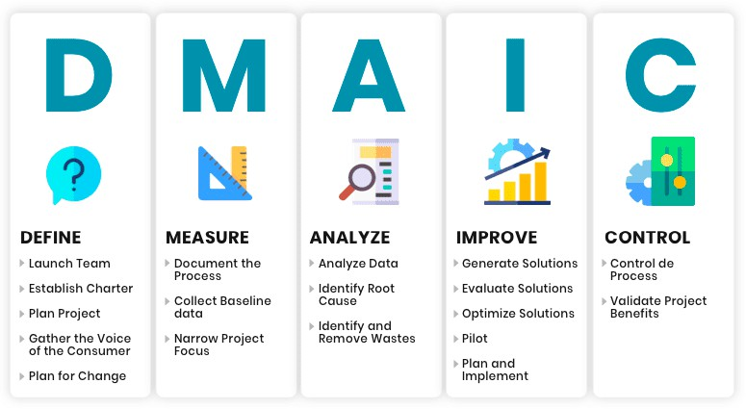

Slide 33
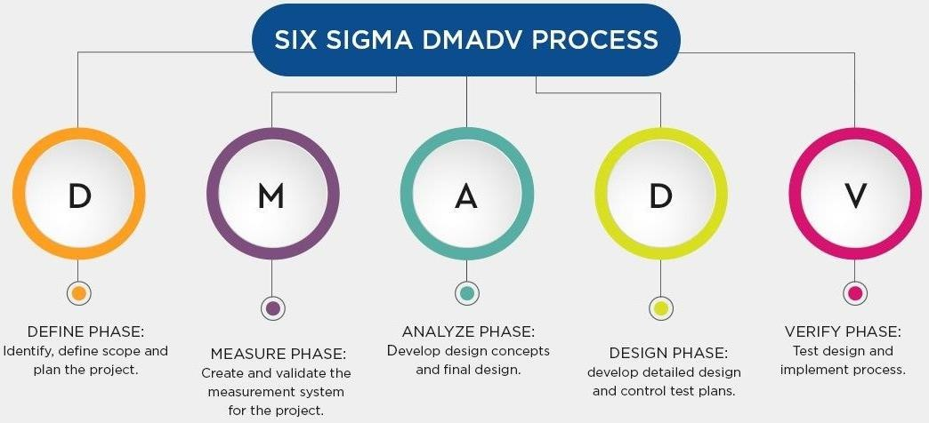

Slide 34
Microsoft (MSFT) is one of the largest software producers in the world. It used Six Sigma to help eradicate defects in its systems and data centers and systematically reduce IT infrastructure failures.
The company first established standards for all of its hardware and software to create a baseline measurement for detecting defects. It then used root-cause analysis, including collecting data from past high-priority incidents, server failures, and recommendations from product group members and customers, to pinpoint potential problem areas.
Large amounts of data were collected on a daily and weekly basis from various servers. The incidents were prioritized based on how severely the defects affected the business and the company's underlying services. Data analysis and reporting identified the specific defects, after which remediation steps for each defect were established.
As a result of Six Sigma, Microsoft says it improved the availability of its servers, boosted productivity, and increased customer satisfaction.

Slide 35
Quality Standards Models - ISO
A quality assurance system may be defined as the organizational structure, responsibilities, procedures, processes, and resources for implementing quality management.
The international set of standards used in the development of quality management
systems in all industries is called ISO 9000
ISO 9000 standards can be applied to a range of organizations from manufacturing
through to service industries.
ISO 9001, the most general of these standards, applies to organizations that design, develop, and maintain products, including software.
The ISO 9001 standard was originally developed in 1987

Slide 36
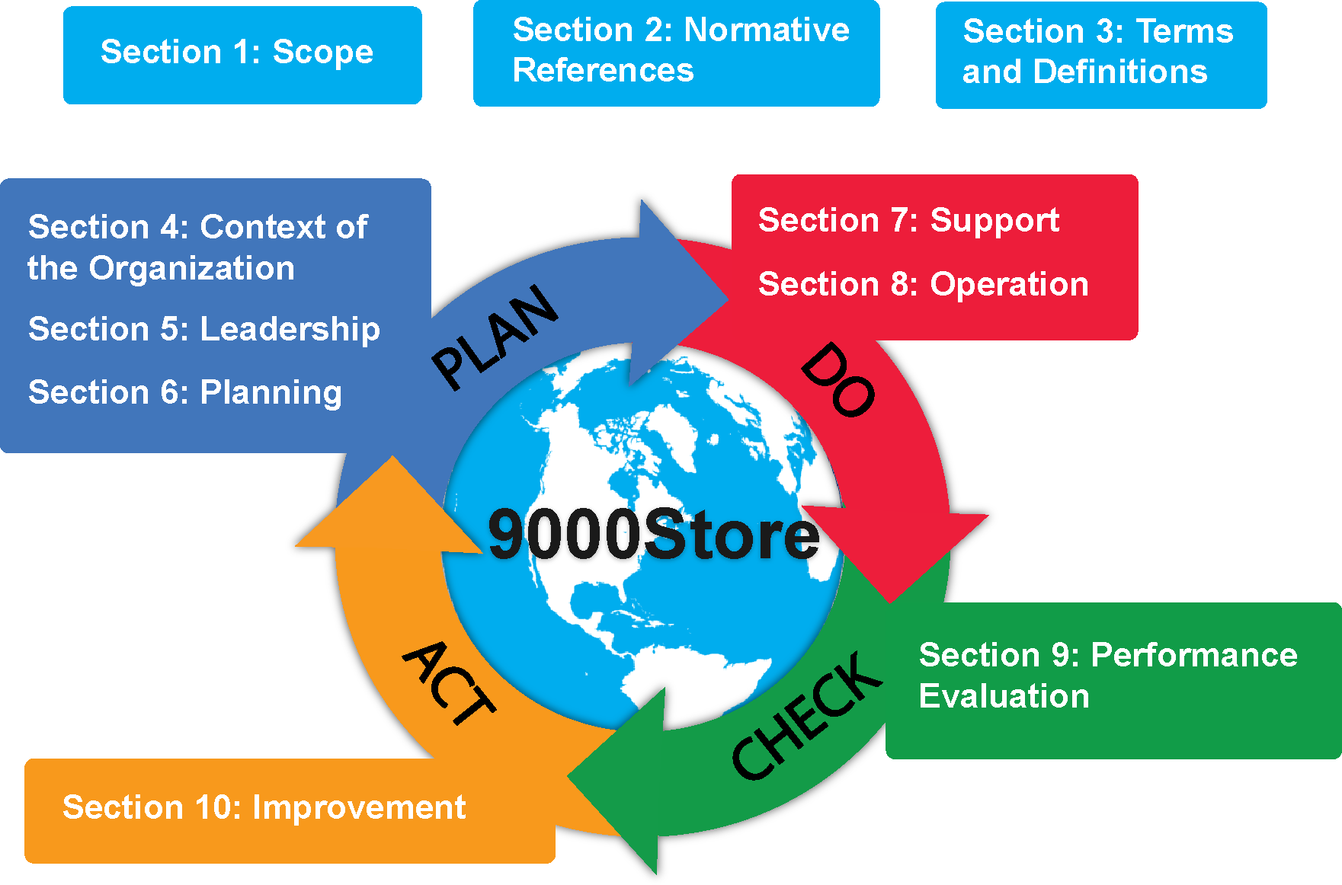

Slide 37
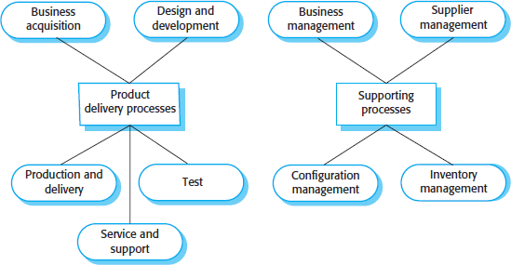
A major revision of the ISO 9001 standard in 2000 reoriented the standard around
nine core processes
If an organization is to be ISO 9001 conformant, it must document how its processes
relate to these core processes.
It must also define and maintain records demonstrating that the defined organizational processes have been followed.
The company quality manual should describe the relevant processes and the process data
that has to be collected and maintained.

Slide 38
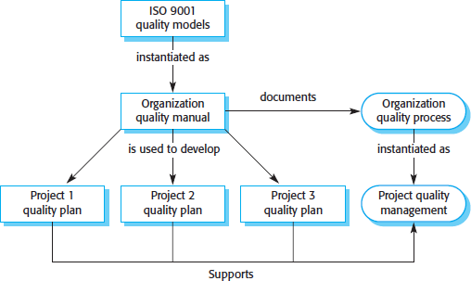
The relationships between ISO 9001, organizational quality manuals, and individual
project quality plans are shown in figure.
This diagram explains how the general ISO 9001 standard can be used as a basis for
software quality management processes.

Slide 39
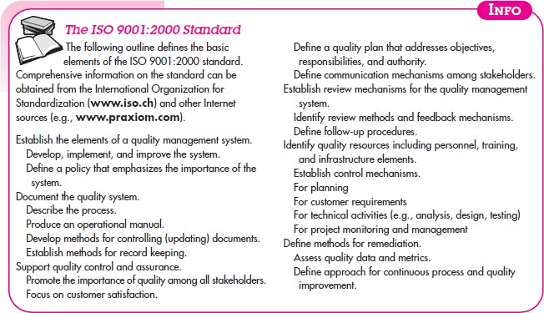

Slide 40
ISO 9000 Quality Standards
ISO (International Standards Organization) is a group or consortium of 63 countries established to plan and fosters standardization. ISO declared its 9000 series of standards in 1987. It serves as a reference for the contract between independent parties.
The ISO 9000 standard determines the guidelines for maintaining a quality system. The ISO standard mainly addresses operational methods and organizational methods such as responsibilities, reporting, etc. ISO 9000 defines a set of guidelines for the production process and is not directly concerned about the product itself.

Slide 41
Types of ISO 9000 Quality Standards
The ISO 9000 series of standards assumes that if a proper stage is followed for production, then good quality products are bound to follow automatically. The types of industries to which the various ISO standards apply are as follows.
1.ISO 9001: This standard applies to the organizations engaged in design, development, production, and servicing of goods. This is the standard that applies to most software development organizations.
2. ISO 9002: This standard applies to those organizations which do not design products but are only involved in the production. Examples of these category industries contain steel and car manufacturing industries that buy the product and plants designs from external sources and are engaged in only manufacturing those products. Therefore, ISO 9002 does not apply to software development organizations.
3. ISO 9003: This standard applies to organizations that are involved only in the installation and testing of the products. For example, Gas companies.

Slide 42
An organization determines to obtain ISO 9000 certification applies to ISO registrar office for registration. The process consists of the following stages:
1. Application: Once an organization decided to go for ISO certification, it applies to the registrar for registration.
2. Pre-Assessment: During this stage, the registrar makes a rough assessment of the organization.
3. Document review and Adequacy of Audit: During this stage, the registrar reviews the document submitted by the organization and suggest an improvement.
4. Compliance Audit: During this stage, the registrar checks whether the organization has compiled the suggestion made by it during the review or not.
5. Registration: The Registrar awards the ISO certification after the successful completion of all the phases.
6. Continued Inspection: The registrar continued to monitor the organization time by time.

Slide 43
Why ISO Certification required by Software Industry?
There are several reasons why software industry must get an ISO certification. Some of reasons are as follows :
This certification has become a standards for international bidding.
It helps in designing high-quality repeatable software products.
It emphasis need for proper documentation.
It facilitates development of optimal processes and totally quality measurements

Slide 44
Total Quality Management (TQM)

Slide 45
Total Quality Management (TQM)
Total quality management (TQM) is an ongoing process of detecting and reducing or eliminating errors.
TQM is used to streamline supply chain management, improve customer service, and ensure that employees are properly trained.
The focus is to improve the quality of an organization’s outputs, including goods and services, through the continual improvement of internal practices.
Total quality management aims to hold all parties involved in the production process accountable for the overall quality of the final product or service.
There are often eight guiding principles to TQM that range from focusing on customers, to continually improving, and adhering to processes.

Slide 46
Principles of TQM
1. Focus on Customers
Under TQM, your customers define whether your products are high quality.
Customer input is highly valued because it allows a company to better understand the needs and requirements in the manufacturing process.
Customer surveys may reveal insufficient durability of goods. This input is then fed back into TQM systems to implement better raw material sourcing, manufacturing processes, and quality control procedures.
2. Commitment by Employees
Employees must buy into the processes and system if TQM is going to be successful.
This includes clearly communicating across departments and leaders what goals, expectations, needs, and constraints are in place.
A company adopting TQM principles must be willing to train employees and give them sufficient resources to complete tasks successfully and on time.
TQM also strives to reduce attrition and maintain knowledgeable workers.

Slide 47
3. Improve Continuously
A company should gradually evolve and strive for incremental, small improvements as it learns more about its customers, processes, and competition.
This concept of continuous improvement helps a company adapt to changing market expectations.
It allows for greater adaptability to different products, markets, customers, or regions.
Continuous improvement also drives and widens the competitive advantage that a company has built over related companies.
4. Adherence to Processes
TQM’s systematic approach relies heavily on process flowcharts, TQM diagrams, visual action plans, and documented workflows.
Every member engaged in the process must be aware and educated on their part of the process to ensure proper steps are taken at the right time of production.
These processes are then continually analyzed to better understand deficiencies in the process.

Slide 48
5. Strategic and Systematic Approach
A company’s processes and procedures should be a direct reflection of the organization’s vision, mission, and long-term plan.
TQM calls for a system approach to decision-making that requires that a company dedicate itself to integrating quality as its core component and making the appropriate financial investments to make that happen.
6. Data Utilization
The systematic approach of TQM only works if feedback and input are given to evaluate how the process flow is moving. Management must continually rely on production, turnover, efficiency, and employee metrics to correlate the anticipated outcomes with the actual results.
TQM relies heavily on documentation and planning, and only by utilizing and analyzing data can management understand if those plans are being met.

Slide 49
7. Integrate Systems
One way to utilize data is to integrate systems.
TQM strategies believe systems should talk to each other, conveying useful information across departments and making smart decisions.
When goods or inventory are used in one area, another department should have immediate access to that enterprise resource planning (ERP) information.
TQM strives to allow everyone to be on the same page at the same time by linking data sources and sharing information across systems.
8. Communication
Data may transfer between departments freely, but there is a human element to coordinating processes and making sure an entire production line is operating efficiently.
Effective communication plays a large part in TQM to motivate employees, educate members along a process, and avoid process errors, whether it is normal day-to-day operations or large organizational changes.

Slide 50
How to Implement TQM
Identify your company’s existing culture, its core values, and its systems.
Use this information to create a system that will serve as your master plan.
Establish what your customers and clients want and what they expect from your business. Determine how to best meet these expectations and needs.
Create a team of management and employees to guide and implement your goals, and include these efforts in your daily business management process.
Consistently gather feedback from employees and customers to gauge your progress.

Slide 51
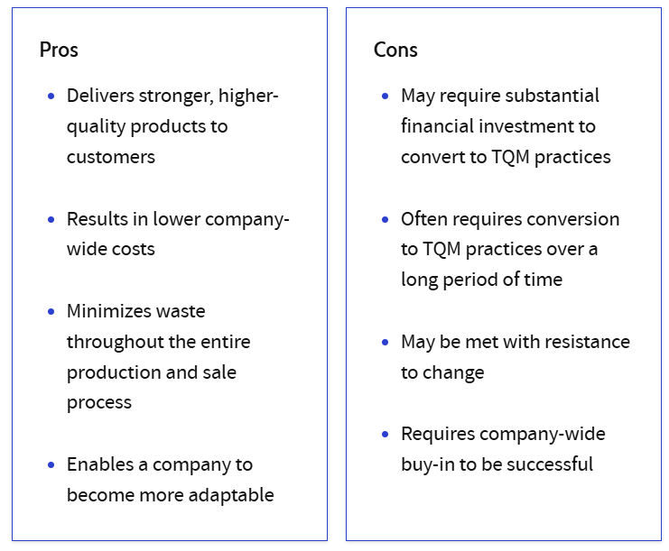
Pros and Cons of TQM

Slide 52
Capability Maturity Model (CMM)

Slide 53
Process Improvement Models: CMM & CMMI
CMM
The Capability Maturity Model (CMM) is a procedure used to develop and refine an
organization's software development process.
It also provides guidelines to enhance further the maturity of the process used to develop those software products.
It is based on intense feedback and development practices adopted by the most
successful organizations worldwide.
CMM was developed and is promoted by the Software Engineering Institute (SEI), a research and development center promote by the U.S. Department of Defense (DOD).
Importance of Capability Maturity Model
Optimization of Resources
Comparing and Evaluating
Management of Quality
Enhancement of Process
Increased Output

Slide 54
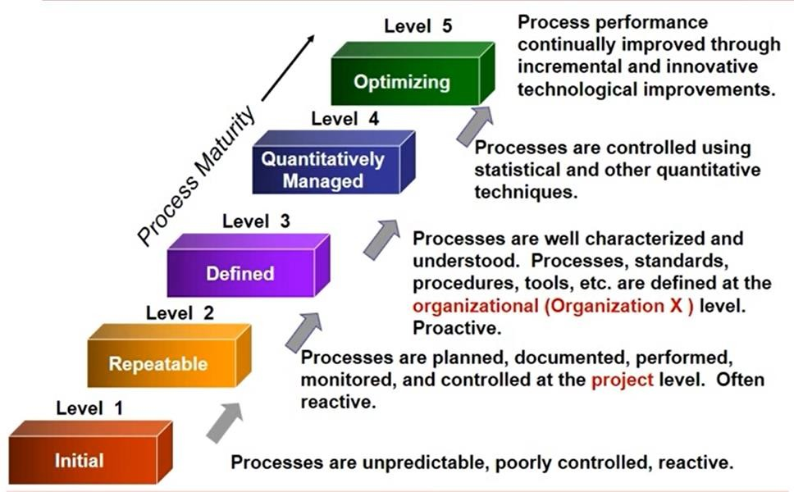
There are five levels to the CMM development process.

Slide 55
CMMI (Capability Maturity Model Integration)
CMMI is a process improvement framework that provides organizations with
guidelines for developing and refining their processes to
performance, quality, and efficiency.
The Capability Maturity Model Integration (CMMI) is based on four pillars:
improve
Capability :
A capable process consistently produces output that is within its specifications.
Execution of capable process always gives predictable results.
Maturity
Maturity means that whatever the company is doing, the company does it in a way that is well-documented, where everyone knows what is expected of them, where performance is not dependent on heroes, and where decisions are made on proper analysis of the situation.
Model
A model is a framework or way of doing something.
CMMI only provides a framework to define processes at your organisation and it does not give exact process details.
It only guides to implement efficient and effective processes.

Slide 56
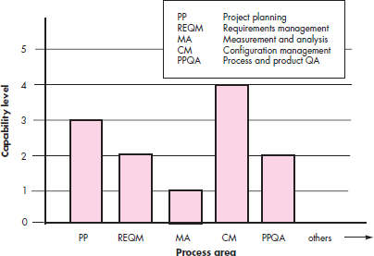
Integration
From a historical point of view CMMI was a fusion of proven practices from a number of different Software and System Development capability maturity models.
The CMMI represents a process meta-model in two different ways:
as a “continuous” model
as a “staged” model
The CMMI defines each process area in terms of “specific goals” and the “specific practices” required to achieve these goals.
Specific goals establish the characteristics that must exist if the activities implied by a process area are to be effective.
Specific practices refine a goal into a set of process-related activities.
The continuous CMMI metamodel describes a process in two dimensions ie Process area and Capability area.

Slide 57
Each process area is formally assessed against specific goals and practices and is rated according to the following capability levels:
Level 0: Incomplete
The process area (e.g., requirements management) is either not performed or does not achieve all goals and objectives defined by the CMMI for level 1 capability for the process area.
Level 1: Performed
All of the specific goals of the process area (as defined by the CMMI) have been satisfied.
Work tasks required to produce defined work products are being conducted.
(iii) Level 2: Managed
All capability level 1 criteria have been satisfied.
All work associated with the process area conforms to an organizationally defined
policy
All people doing the work have access to adequate resources to get the job done; stakeholders are actively involved in the process area as required
All work tasks and work products are “monitored, controlled, and reviewed; and are
evaluated for adherence to the process description

Slide 58
Level 3: Defined
All capability level 2 criteria have been achieved.
The process is customized based on the organization's standard procedures and guidelines, and it adds work materials, measurements, and other information to improve the organization's processes.
Level 4: Quantitatively managed
All capability level 3 criteria have been achieved.
The process area is controlled and improved using measurement and quantitative assessment.
We set specific goals for quality and how well the process works, and we use these goals to manage the process..
Level 5: Optimized
All capability level 4 criteria have been achieved.
We adjust and improve the process area based on numbers and statistics to meet the
changing needs of customers and to make the process better over time..

Slide 59
Project planning is one of eight process areas defined by the CMMI for “project management” category.
The specific goals (SG) and the associated specific practices (SP) defined for project
planning are
SG 1 Establish Estimates
SP 1.1-1 Estimate the Scope of the Project
SP 1.2-1 Establish Estimates of Work Product and Task Attributes SP 1.3-1 Define Project Life Cycle
SP 1.4-1 Determine Estimates of Effort and Cost
SG 2 Develop a Project Plan
SP 2.1-1 Establish the Budget and Schedule SP 2.2-1 Identify Project Risks
SP 2.3-1 Plan for Data Management
SP 2.4-1 Plan for Project Resources
SP 2.5-1 Plan for Needed Knowledge and Skills
SP 2.6-1 Plan Stakeholder Involvement
SP 2.7-1 Establish the Project Plan
SG 3 Obtain Commitment to the Plan
SP 3.1-1 Review Plans That Affect the Project SP 3.2-1 Reconcile Work and Resource Levels SP 3.3-1 Obtain Plan Commitment

Slide 60
The CMMI also defines a set of five generic goals(GG) and related practices for each process area.
Each of the five generic goals corresponds to one of the five capability levels
GG 1 Achieve Specific Goals
GP 1.1 Perform Base Practices
GG 3 Institutionalize a Defined Process
GP 3.1 Establish a Defined Process
GP 3.2 Collect Improvement Information
GG 2 Institutionalize a Managed Process GP 2.1 Establish an Organizational Policy GP 2.2 Plan the Process
GP 2.3 Provide Resources GP 2.4 Assign Responsibility GP 2.5 Train People
GP 2.6 Manage Configurations
GP 2.7 Identify and Involve Relevant
Stakeholders
GP 2.8 Monitor and Control the Process GP 2.9 Objectively Evaluate Adherence GP 2.10 Review Status with Higher-Level
Management
GG 4 Institutionalize a Quantitatively Managed Process
GP 4.1 Establish Quantitative Objectives for
the Process
GP 4.2 Stabilize Subprocess Performance
GG 5 Institutionalize an Optimizing Process
GP 5.1 Ensure Continuous Process Improvement
GP 5.2 Correct Root Causes of Problems

Slide 61
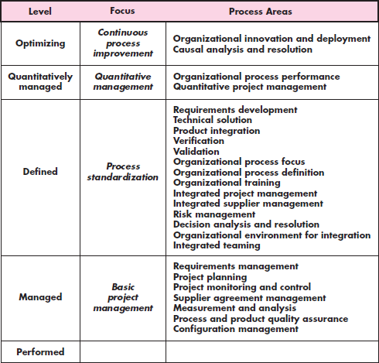
The staged CMMI model defines the same process areas, goals, and practices as the continuous model.
The primary difference is that the staged model defines five maturity levels, rather than five capability levels.
To achieve a maturity level, the specific goals and practices associated with a set of process areas must be achieved.
The relationship between maturity levels and process areas is shown

Slide 62
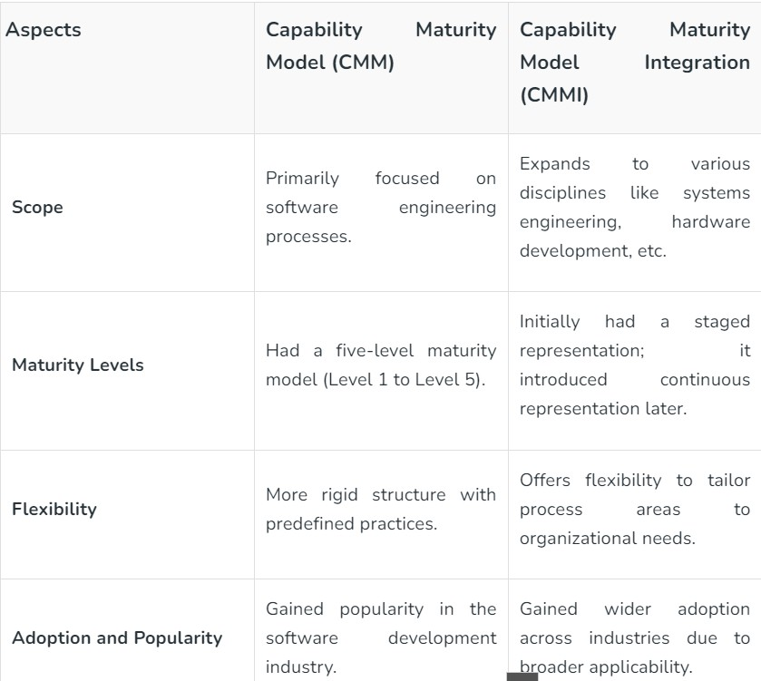

Slide 63
Quality Control and Quality Assurance

Slide 64
Quality Assurance
Software quality assurance is (also known as QA) a sequence of tasks to prevent defects and ensure that the techniques, methods, approaches, and processes are designed for a specific application must be implemented correctly.
This is an ongoing process within the development of a software system.
The development of units of an application is checked under the quality assurance specifications in the sequence of their development.
Quality assurance test ensures the development of high-quality software because of its main focus on the high-quality processes, good quality management system and periodic conformance audit during the development of software.
It is a managerial tool includes planned and systematic activities and documentation to prevent problems related to quality.

Slide 65
Quality Control
Quality Control also known as QC is a sequence of tasks to ensure the quality of software by identifying defects and correction of defects in the developed software.
It is a reactive process, and the main purpose of this process is to correct all types of defects before releasing the software.
The process is done by eliminating sources of problems (which cause to low the quality) through the corrective tools so that software can meet customer's requirements and high quality.
The responsibility of quality control is of a specific team which is known as a testing team that tests the defects of software by validation and corrective tools.
Quality Control provides identification of defects.
Quality Control is product oriented.
Quality Control is a corrective tool.
Testing team is responsible for Quality control.
Quality Control is a reactive process.

Slide 66
Points | Quality Assurance | Quality Control
Definition | QA is a group of activities which ensures that the quality of processes which is used during the development of the software always be maintained. | QC is a group of activities to detect the defects in the developed software.
Focus | The focus of QA is to prevent defects in the developing software by paying attention to processes. | The focus of QC is to identify defects in the developed software by paying attention to testing processes.
How | Establishment of the high-quality management system and periodic audits for conformance of the operations of the developing software. | Detecting and eliminating the quality problem elements by using testing techniques and tools in the developed software.
What | QA ensures prevention of quality problem elements by using systematic activities including documentation. | QC ensures identification and elimination of defects by using processes and techniques to achieve and maintain high quality of the software.
Orientation | QA is process oriented. | QC is product oriented.
Type of process | QA is a proactive process. It concerns to improve development so; defects do not arise in the testing period. | QC is a reactive process because it concerns to identify defects after the development of product and before its release.
Responsibility | Each and every member of the development team is responsible for QA | Only the specific testing team is responsible for QC
Example | Verification is the example of QA | Validation is the example of QC

Slide 67
Quality Management

Slide 68
Software Quality Management
Software quality management is a systematic process of ensuring that software meets the highest standards in terms of functionality, reliability, and user satisfaction.
It is a disciplined approach to overseeing and enhancing all aspects of software development, deployment, and maintenance to ensure the final product meets or exceeds user expectations.
It encompasses processes, standards, and practices that focus on functionality, performance, reliability, and user satisfaction, ultimately creating high-quality software products.
Software Quality Management (SQM) is the process of constant improvement of product quality, integrated into the development process until the expectations are achieved.
Software quality management aims to create a working environment where quality is the responsibility of everyone on the team.

Slide 69
Why Software Quality Management is Important?
Software Quality Management is important because it helps to identify and correct errors in software, which is essential for the effective implementation of a project.
The quality of the software is simply the measurement of how well the product has been able to fulfill your needs.
It is measured by how often errors are found and repaired, how well the software works under different conditions, and how easily software can be maintained.
Software quality is determined by comparing actual results against the expected results.
If a project fails to meet its objectives because of poor quality, then the project will be a failure.
Software quality can include a large variety of factors such as degree of completeness, efficiency, usability, correctness, and reliability.

Slide 70
What are Software Quality Management Metrics?
Software quality management metrics are quantitative measurements used to assess the various aspects of software development, deployment, and maintenance processes.
These metrics provide objective data that help evaluate the quality of software products, processes, and teams.
They offer insights into the effectiveness of quality management efforts and enable informed decision-making.
The main focus here is to understand the quality, complexity, software improvement, and development speed.

Slide 71
5 Aspects of Software Quality:
Software quality can be measured in terms of its ability to perform its required functions and meet its specified requirements. The five aspects of software quality are:
Performance: Performance refers to how well a system performs its functions or meets user requirements.
Usability: Usability relates to the ease with which users can use the system and understand it.
Reliability: Reliability relates to the ability of a system to continue operating without breakdown or failure.
Maintainability: Maintainability refers to how easy it is to understand and modify code so that changes can be made easily when necessary.
Interoperability: Interoperability refers to whether a system will work with other systems or programs without difficulty or incompatibility issues.

Slide 72
How Does Software Quality Management Work?
There are a series of steps in software quality management that ensure the delivery of high-quality software products. Here’s an overview for you:
Defining Quality Objectives: Establish clear quality objectives that align with the project’s goals and customer requirements.
Requirements Analysis: Thoroughly understand and document the software requirements. This step ensures that the development team has a clear understanding of what needs to be built and what quality standards should be met.
Quality Planning: Develop a comprehensive quality plan that outlines the strategies, processes, and methodologies to achieve the defined quality objectives. This plan includes details about testing, review processes, quality checks, and performance benchmarks.
Risk Assessment: Identify potential risks that could impact software qualit and develop mitigation strategies to address them, ensuring that potential quality issues are managed proactively.
Quality Assurance: Implement processes and practices that ensure adherence to quality standards throughout the development lifecycle. This includes conducting reviews, audits, and inspections to identify defects and inconsistencies.
Quality Control: Execute testing procedures to identify defects and verify that the software meets the specified requirements. This involves various testing types, such as unit testing, integration testing, system testing, and user acceptance testing.
Continuous Monitoring: Continuously monitor the software development process to track progress, identify deviations from the quality plan, and address any issues promptly.
Metrics and Measurement: Collect and analyze relevant metrics to assess the software’s quality, performance, and progress to get insights into the effectiveness of quality management efforts.

Slide 73
Benefits of Software Quality Management
Improves product quality.
Adds to customer satisfaction.
The software meets user needs and expectations and generates more value, leading to increased user adoption and potentially higher revenue.
Helps bring down the cost of rework as defects are detected early in SDLC. Assists in making credible and reliable product development decisions and test management strategies.
Increases productivity.

Slide 74
Quality Factors

Slide 75
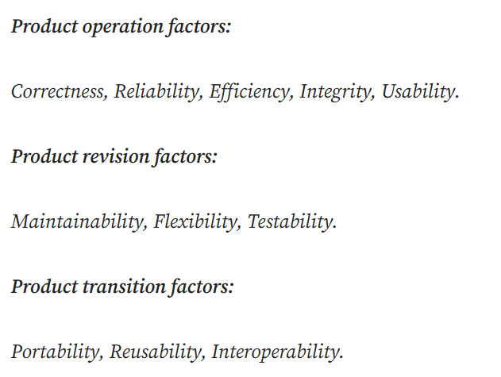
Software Quality Factors

Slide 76
Product operation factors
Product operation factors includes five software requirements. These requirements directly affect to the software operations such as operational performance, ease of usage and etc. These 5 factors help to provide a better user experience to users.
Correctness
Correctness means a program satisfy all its specifications. Correctness is the capability of software to perform the operations that were designed to perform.
In the correctness consider what are the things need to output, Accuracy of output ,Completeness of output information , Up-to-date of the information and Availability of the information
Reliability
Reliability means a program capable to be maintained so that it can perform its exact function. Reliability requirements deal with software product failure.
Efficiency
Efficiency requirements deal with the computer resources that include in a system to complete its functions.
Integrity
Integrity requirements deal with the software system security. This help to prevent access to unauthorized persons, to distinguish between the majority of personnel allowed to see the information and a limited group who will be allowed to add and change data in a system.
Usability
Usability means the requirements for staff to execute the software-based system and a new staff member training on this system. And usability deal with the quality of a user’s experience when interacting with products and systems.

Slide 77
Product revision factors
Product revision factors includes three software quality factors.
These are Maintainability, Flexibility and Testability.
These requirements are required for testing and maintenance of the software.
They provide ease of maintenance, flexibility and testing effort to support the software to be functional according to the needs and requirements of the user in the future.
Maintainability
Maintainability considers the efforts that will be needed by users and maintenance personnel to identify the reasons for software failures, to correct the failures, and to verify the success of the corrections.
Flexibility
Flexibility means capabilities and effort needed to improve an operational software program.
Testability
Testability means effort and capabilities required to verify a software system to ensure software meets the specified requirements.
Testability requirements deal with the testing of an information system as well as with its operation.

Slide 78
Product transition factors
Product transition factors includes three software quality factors.
There are Portability, Reusability and Interoperability.
That allows the software to adapt to the change of environments in the new platform or technology from the used platform or technology.
Portability
Portability means software program adaptation with different platforms and different environments continue using the same software.
EX: different operating systems , different hardware.
Reusability
Reusability requirements deal with the use of software modules originally designed for one project in a new software project currently being developed.
Interoperability
Interoperability requirements is , the effort required to integrate two systems with one another.
EX: the firmware of the production machinery and testing equipment interfaces with the production control software.

Slide 79
Methods of Quality Management

Slide 80
15 Strategies to Improve Software Quality
1. Test Early
Testing is important when learning how to improve software quality and shouldn’t be neglected.
Testing aims to catch defects early during the design phase so they don’t snowball and grow into bigger issues later.
Software development teams resort to manual testing for many problems, but companies leverage automated testing strategies for non-UI tasks.
Testing early also invariably reduces the money spent on bug fixes.
A defect that could cost your company $100 in the requirements phase can cost $10,000 or more in the product implementation stages.

Slide 81
2. Implement Cross Browser Testing
Cross browser testing checks if the software runs seamlessly across different web browsers, screen sizes, and mobile apps.
With multiple devices and models coming out in the market, cross browser testing is becoming integral for every developer.
There are many upsides associated with cloud-based cross browser testing, and effective testing solutions lead to a flawless user experience.
You can cut costs, optimize the speed and performance of your products, and ensure that testing environments stay scalable and dynamic using various cross-browser testing tools.
For best results, combine parallel testing and testing automation tools.
3. Test on Multiple Devices
Multi-device testing will help you make better decisions regarding software development and quality improvement processes.
There is an overwhelming number of devices, screen sizes, and OS configurations in the market, so it’s important to test as many variations as possible.
Windows and Mac are the two most popular operating systems used for testing purposes, and web browsers such as Chrome, Safari, Opera, and Firefox cover most of the users.
Using the same configurations as end-users when testing software on these browser and OS environments is vital.
Testing tools like BrowserStack gives developers access to real-time environments without having to install additional hardware on machines.

Slide 82
4. Optimize Automation Testing
Increasing adoption of Automated testing and Agile methodologies has led to improvements in software quality.
According to a 2020-21 World Quality Report, automation testing tools can save time, enhance coverage, minimize human errors, and improve testing capabilities.
Some popular approaches are smoke testing, regression testing, cross-device and cross-browser testing, and load testing.
There are various automated testing tools, and it’s critical to strike a balance between manual and automated testing methods.
Most automated testing solutions can be integrated with Agile workflows and be a core component of DevOps practices.
5. Use Quality Controls from the Beginning
Quality management and control is an ongoing process, so testers must cooperate with developers and work together.
A structured approach effectively improves test processes and cuts maintenance costs with native testing tools.

Slide 83
6. Leverage Continuous Delivery (CD) and Continuous Integration (CI)
CI-CD requires engineers to integrate changes and improvements to every step of the software development lifecycle.
Continuous Delivery focuses on releasing changes to customers interactively, while continuous integration makes code more dependable by integrating modifications to a product multiple times daily.
7. Have Clear Communication
Clear communication with all team members is integral to the software quality improvement process.
Having consistent KPIs (Key Performance Indicators) throughout the project and conveying accurate test reports helps in communicating.
Everybody should be aligned when setting testing requirements and sharing feedback.
It’s critical to get all stakeholders involved in meetings and ensure team members communicate with vendors and do not work in isolation.
8. Create a Risk Registry
Risk management is critical to software quality improvement, and project managers know they must monitor risks throughout the development lifecycle.
A project risk register is also called a risk log, and it is used to identify, track, and analyze potential risks.
Your team members should create a risk registry to record these risks, assess them, and assign appropriate priority levels for effective mitigation.

Slide 84
9. Document Your Project Requirements
Good documentation defines the scope of the project, milestones, deliverables, and technical specifications, thus ensuring you meet deadlines and stay on track.
The documentation also defines customers’ needs and lists functional and non-functional requirements.
More importantly, it contains a list of all important features and processes with step-by-step breakdowns that help keep track of the development process.
The first step to creating effective documentation is communicating to clients and collecting information about their expectations.
All development processes and plans should follow the documentation based on them.
10. Think Outside the Box
Promoting innovation and thinking outside the box should be a no-brainer. Simply copying your competitor’s strategy or growth hacks isn’t enough.
People crave “different,” and you will stand out if you build a unique product that others cannot replicate.
To improve software quality, think about what you stand for.
Automate monotonous processes to free up time for productive tasks and use quality metrics with your testing structures.

Slide 85
11. Incorporate Employee Training
Your employees can play the role of your end-users.
Tools, technologies, and techniques evolve, and it’s important to stay on track with the latest trends.
Employee training instills an awareness of what to look out for in leading software products.
Flaws and vulnerabilities your team normally wouldn’t notice during user journeys will crop up.
Employees should also work on upgrading their coding skills to contribute to the software development process.
12. Create a Quality Management Plan
A quality management plan (document) outlines software quality expectations, defines roles and responsibilities, supports project managers, and organizes tasks to ensure that software development matches customer requirements and expectations.
It has key components such as reporting tools and assurance policies, quality standards, testing strategies, and software quality objectives.
Think of it as a roadmap for future improvements with the foundation set in stone.
13. Do Formal Technical Reviews
In a formal technical review, the stakeholders meet and discuss the logical and functional errors of a software program.
These review rounds require a team of engineers and entail preparing reports for presentations.
The main objective is to give all reviewers a product walkthrough, examine source code, detect bugs, and make additional inspections.
These reviews improve the software quality and help keep developers accountable for the production management process.

Slide 86
14. Try Ad Hoc and Exploratory Testing
Ad hoc and exploratory testing go into the manual side of testing.
The main idea is to explore creativity and push the boundaries of testing practices.
There are no rules to this, and exploratory testing is conducted on the fly at any moment.
This approach benefits developers in testing software usability and user behaviours.
Ad hoc testing uses random data to generate tests and aims to break or disrupt software services.
Its objective is to find vulnerabilities and is usually done near the end of the development process.
15. Produce Bug Reports
A good bug report can make software testing and improvement highly effective.
It includes all possible scenarios, and use-cases and describes behaviours exhibited while testing new features.
You can add screenshots of failure exceptions in the report, list all possible solutions, and a bug summary.

